Slide 1
The importance of planning and stakeholder engagement Clara Heath MAX toolkit webinar series Nov-Dec 2016

Slide 2
Purpose of webinar
Outline how planning and stakeholder engagement can maximise the relevance, value and use of survey data
Introduce relevant elements of the MAX toolkit
Hopefully convince you to read the MAX planning guide and consider making changes to your existing planning processes

Slide 3
Why develop a planning guide?
Earlier activities and consultations with LA staff indicated that minor amendments to existing planning processes can have a number of benefits.
Overcome barriers
Maximise local value of data
Save time + resources
Most participating LAs experienced barriers and did not use data for local performance improvements.
Additional planning guidance could be useful + help ensure that the considerable money and resources allocated to the ASCS and PSS SACE is not wasted.

Slide 4
And why include engagement tools?
LAs who used data locally also engaged with relevant survey stakeholders (e.g. potential consumers of data, i.e. LA decision-makers).
LAs who did not use data locally often did not engage or reported engagement difficulties (e.g. identifying relevant stakeholders, convincing stakeholders to engage with the surveys).
This suggests that engagements with survey stakeholders can support the planning processes and that guidance in the MAX toolkit would be useful.

Slide 5
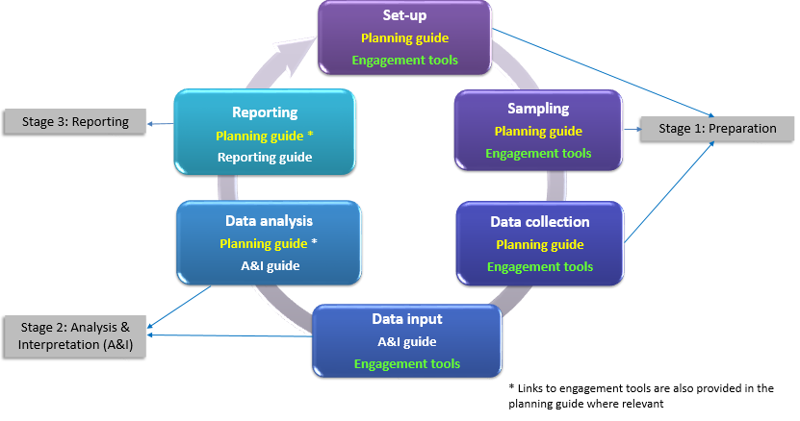
Planning element of MAX Toolkit

Slide 6
The MAX planning guide
Aim of MAX planning guide is to:
Encourage you to see the ASCS and PSS SACE as a (very large) piece of local research - not just another data collection! and to
Show you how you to transform your survey data into meaningful results that can guide local performance improvements.
Engagement tools are provided to support planning along with recommendations on how to implement strategies when engagement is not possible.

Slide 7
Planning the survey process
Minor amendments to existing planning processes can transform ASCS and PSS SACE data into meaningful results by helping you to:
Identify local information needs
Fulfil local information needs using survey data + existing resources
Focus analysis to produce ‘useful’ information

Slide 8
Identify local information needs
What information do decision-makers in my organisation need to inform local practice and performance improvements?
Engage with decision-makers
Attend senior management team meeting
Best way to identify & prioritise info needs?
Conduct a document review
Local accounts, JSNAs, survey reports
Useful strategy if engagement not possible
Refer to MAX reporting guide
Focus on info needs identified by other LAs
Useful strategy is 1 and 2 not possible

Slide 9
Examples of local information needs
Are any service users or carers reporting poor outcomes?
Why do some of our service users feel unsafe?
What may explain this?
How do we compare to other LAs and the national average?
What may explain any variations in performance?
What factors are associated with good QOL?
What do we need to do to improve reported outcomes?

Slide 10
Tools to support you
Planning and engagement tools
Guide to engaging with potential consumers of ASCS and PSS SACE data
Guide to conducting a desk-based document review
Inspiration if no opportunities to engage or not enough time
MAX reporting guide
Further analysis case studies report

Slide 11
Fulfil local information needs
How can I fulfil local information needs using survey data and existing resources?
Focused analysis
Relationships between variables?
Differences between respondent groups?
Local modifications
Add questions and comments boxes?
Increase sample size?
Other data
LA records, findings from local research?
National surveys?

Slide 12
Establishing how to fulfil local info needs
What kinds of analysis would fulfil local information needs? Quantitative analysis, qualitative analysis, both?
Are the right questions in the survey? If not, add local questions [consult NHS Digital Question Bank + seek permission]
Is the sample large enough? If not, modify sample frame [use NHS Digital sample size calculator + seek permission]
What additional data would supplement analysis findings? Local research, LA records, national surveys?
See LA case study examples in MAX toolkit for inspiration

Slide 13
Example
Why do some of our service users feel unsafe?
Question | Strategy
What kinds of analysis? | Quantitative analysis to identify factors associated with unmet safety needs (respondent characteristics + explanatory measures) + qualitative analysis of respondent comments
Are the right Qs in the survey? | No. Need more qualitative data. Add comments box to safety question (e.g. what (if anything) makes you feel unsafe?)
Other useful data? | Findings from local research and consultations, LA records, feedback from front-line staff

Slide 14
Tools to support you
Planning and engagement tools
Guide to engaging with potential consumers of ASCS and PSS SACE data
Establishing strategies to fulfil local information needs guide
Inspiration if no opportunities to engage or not enough time
MAX analysis and interpretation guide and tools
Further analysis case studies report

Slide 15
Focus analysis
Considerations of the most appropriate strategies for fulfilling local information needs will help you to move beyond the ‘descriptives’ and focus your analysis plans to explore the:
Relationships between survey variables
Differences between respondent groups
Potential reasons underlying tick box responses
These strategies are described in more detail in other webinars and in the analysis element of the MAX toolkit.

Slide 16
Planning tools in the MAX toolkit
Tool | Helps you to….
MAX planning guide | Plan the survey process to maximise the local relevance and value of ASCS and PSS SACE data.
Guide to conducting a document review (plus template) | Identify potential local information needs without engaging with potential stakeholders
Establishing strategies to fulfil local information needs guide | Consider the best strategies for fulfilling local inform needs with survey data and other existing resources.
Optional tools are also provided for users who wish to develop a planning vision or strategy. Links to all tools are provided in the MAX Planning guide

Slide 17
Engagement tools in the MAX toolkit
Tool | Helps you to….
Guide to identifying potential ASCS and PSS SACE stakeholders | Identify potential stakeholders within and beyond your organisation and understand the value of engaging with them.
Guide to engaging with potential consumers of ASCS and PSS SACE data | Establish and maintain engagements with commissioners & managers during the survey process to identify and fulfil local info needs.
Survey development summaries and promotional materials | Encourage LA decision-makers to engage with you and the surveys

Slide 18
Further info or feedback
To find out more about the MAX project, download the reports on earlier research activities or access the MAX toolkit:
Website: www.maxproject.org.uk
Email: maxproject@kent.ac.uk
Call: 01227 823963
Please also feel free to provide feedback on how the MAX toolkit can be improved.

Slide 19
Disclaimers
Department of Health disclaimer: the research on which this presentation is based is funded by the Department of Health and undertaken by researchers at the Quality and Outcomes of Person-centred Care Research Unit (QORU). The views expressed are not necessarily those of the Department.
MAX toolkit disclaimer: the draft guides, tools and templates are confidential and have been issued for the purpose of restricted consultation. They should not be quoted or circulated until finalised and approved for wider publication by the project funder. Registered users, however, are welcome to download and use the toolkit elements of potential relevance and value within their organisation.

